Slide 1

Michigan’s Fiscal Future:
A Long-Term Analysis of Michigan’s
Economy and Budget
Prepared in cooperation with
W.E. Upjohn Institute for Employment Research
South Central Michigan
Economic Forum
February 29, 2008
Citizens Research Council of Michigan

Slide 2
Citizens Research Council of Michigan
Founded in 1916
Statewide
Non-partisan
Private not-for-profit
Promotes sound policy for state and local governments through factual research – accurate, independent and objective
Relies on charitable contributions of Michigan businesses, foundations, and individuals
www.crcmich.org

Slide 3
The Central Message Is:
The State of Michigan has dual structural deficits affecting:
  -Public K-12 education
  -General Fund financed programs
Its causes have both spending and revenue components
We will not grow out of it
Significant spending cuts and/or tax increases will be required

Slide 4
Michigan’s Budget Problems
FY2001 to FY2007
7 years of spending cuts
Major tax cuts since late 1990s
FY2007 General Fund revenues lower than in FY1996
1.4 % growth in School Aid Fund since 2000
$8 billion in one-time resources used including reserves
Cash position worst in nearly 30 years
Weakened connection between revenue structure and the economy
Spending pressures growing faster than revenues – structural not cyclical

Slide 5

Michigan’s Budget Has Undergone Significant Changes

Slide 6
Revenues
Self-inflicted changes in revenue structure
-Tax rate cuts
-Federal changes in tax law
  -Increased use of slow or no-
growth revenue sources (e.g.
tobacco taxes)
Weakening connection of economy with revenues
-Sales Tax
-Income Tax

Slide 7
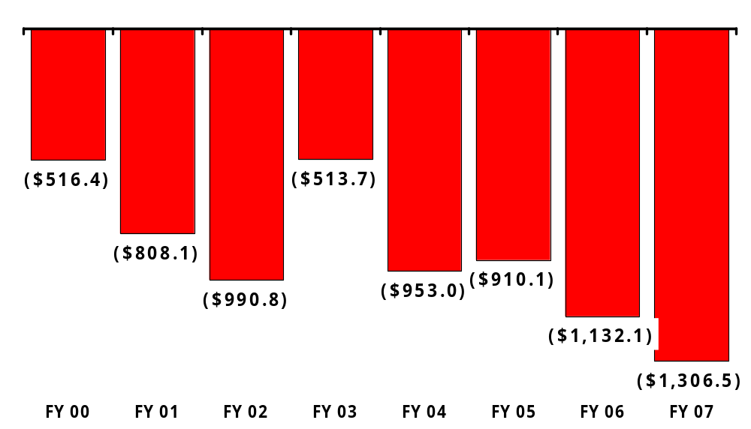
Annual Impact of Tax Cuts
(Millions)
Source: House Fiscal Agency

Slide 8
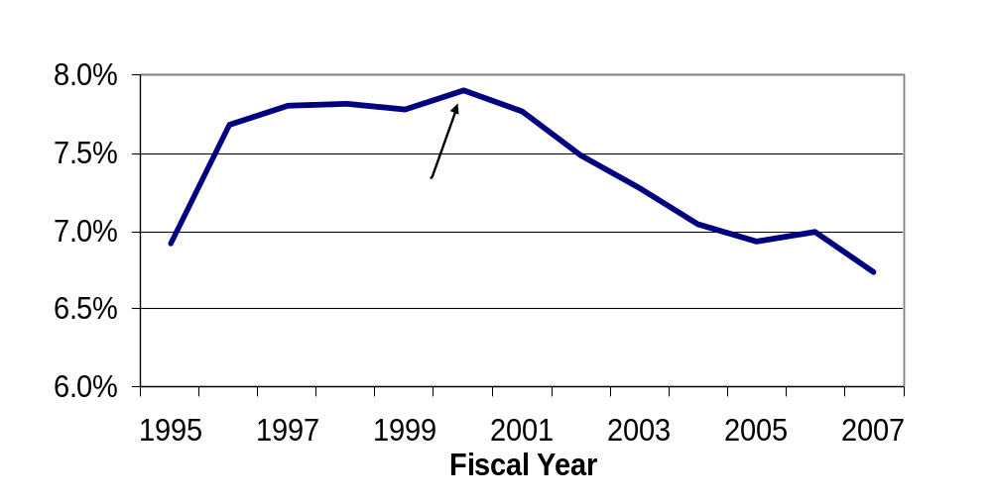
State Taxes as a Percent of
Michigan Personal Income
$5.4 Billion below constitutional revenue limit in 2007

Slide 9
General Fund/School Aid Fund Tax Revenues
 | FY2000 | FY2007 | Annual Rate | Total
Income | $7,101 | $6,441 | -1.4% | -9.3%
Sales | 4,726 | 5,393 | 1.9% | 14.1%
Use | 1,349 | 1,380 | 0.3% | 2.3%
Business | 2,515 | 2,040 | -2.9% | -18.9%
Tobacco | 536 | 676 | 3.4% | 26.0%
Property | 1,381 | 2,081 | 6.0% | 50.6%
Other | 1,085 | 879 | -3.0% | -19.0%
Total | $18,693 | $18,890 |  | 1.0%

Slide 10
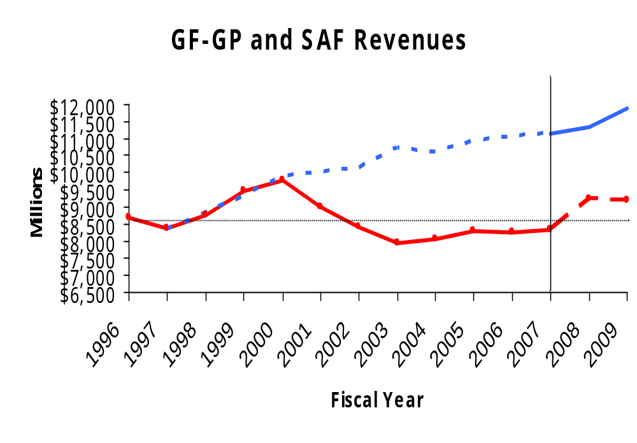
School Aid Fund
GF-GP
FY 1996 GF-GP Level
Source: Michigan Department of Treasury

Slide 11
On the Spending Side: Reductions
Major Areas
Higher Education—$275M in 4 years (13%)
Human Services—$172M in 5 years (14%)
School Aid—$323M in 5 years (84%)
Revenue Sharing—$447M in 5 years (29%)
State employees—9,500 in 6 years (15%)
—smallest workforce since 1974

Slide 12
On the Spending Side:
Increases
Major Areas
Community Health—$594M in 5 years (24%)
  Medicaid program--$244 in 5 years (24%)
Corrections—$211M in 5 years (13%)
  16% of total GF budget in 2001
  20% of total GF budget in 2008, same as higher education

Slide 13
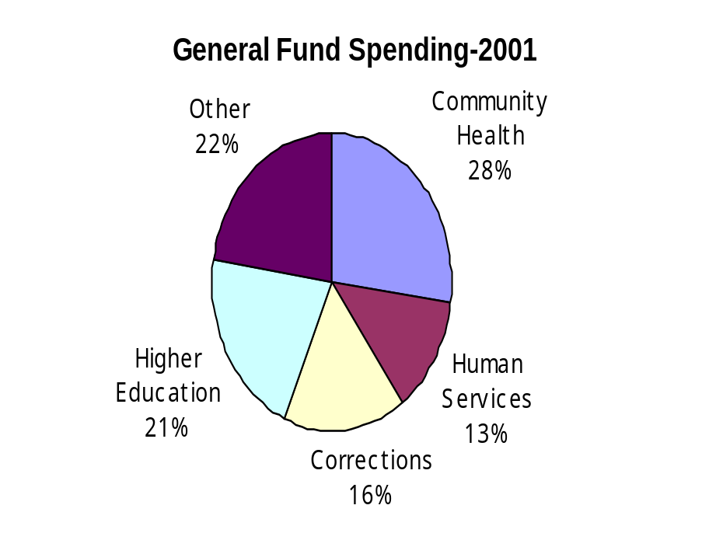
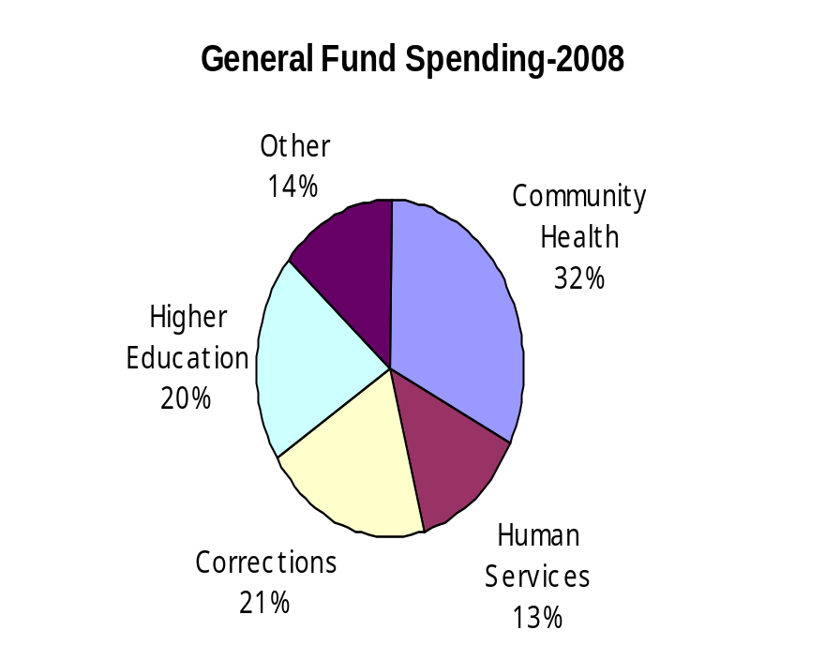
Michigan’s General Fund Budget:
Yesterday and Today
$9.9 Billion
$9.2 Billion

Slide 14
The FY2008 Budget Deal
$1.2 billion in new revenues
-Income Tax $744 Million
-Surcharge on new MBT $479 Million
$440 million in spending reductions (from Gov’s proposal)
General Fund and School Aid Fund budgets balanced
Spending pressure and revenue growth paths essentially unaltered
Fundamental structural deficit problems remain
Risks to revenue:
  New business tax performance
  Financial markets - credit
  Consumer confidence
  Energy prices

Slide 15
Fiscal Year 2009 Economic Outlook
Sluggish Michigan economy
Personal Income up 2.8 percent
Employment declines bottom out after 9 years of decline
Unemployment rate rises to 8.7 percent
Light vehicle sales up about 2 percent

Slide 16
Fiscal Year 2009 Revenues
Weak revenue growth – 2.3% combined
EITC begins phase-in ($134 million)
General Fund revenues decline $53 million from FY2008
School Aid Fund revenues increase $600 million---$342 million offsets local personal property tax revenue losses

Slide 17
Summary of Governor’s Proposal
Factors Making Spending Increases Possible
Total General Fund Spending Unchanged from FY2008
Increased Federal match for Medicaid reduces General Fund requirements $133 million
Corrections efficiency and policy changes save $50 million
One-time delayed higher education payments from FY2008 reduce FY2009 by $165 million
Surplus from FY2008 used-$126 Million
State employee/retiree health care savings-$63 million
Other spending reductions- $122 million
Net maneuvering room-over $600 million

Slide 18
Proposed Spending Increases
General Fund
Higher Education—3% average increase in state support--$62 million
Increases in statutory revenue sharing payments for some local units—others frozen at FY2008 levels--$33 million impact on General Fund
Medicaid caseloads and costs-$196 million
Human Services caseloads-$69 million
Miscellaneous cost increases-$102 million
Program enhancements-$84 million
Increased income and clothing allowance support for needy families (first since 1990)

Slide 19
Proposed Spending Increases
School Aid
Foundation allowance increases-$299 million
Minimum per pupil allowance increases $216 (3%)
Higher spending districts receive smaller increase graded down to $108 for those receiving highest allowance
Preschool programs increase $32 million
Special Education increases $20 million
$300 million bonding program to build smaller high schools in low-achieving districts—debt service $32 million

Slide 20
Road to Budget Passage
Considerably less problematic than last year
Mid-summer completion
Effort to solve structural problems?
Election year
Real problems develop in 2010

Slide 21
Michigan’s Fiscal Future
“If you don’t know where you are going, any road will get you there.” – Lewis Carroll
Projections seldom made beyond the current budget year
Failure to estimate the future consequences of current actions leads to unpleasant surprises
Knowing where we are headed helps justify actions to change the future

Slide 22
Scope of the Analysis
Ten-year scenarios of the Michigan economy with varying assumptions about:
  -Auto industry
  -Office furniture
  -Chemicals
  -Hi-tech
W.E. Upjohn staff used Regional Economic Models, Inc. (REMI) to prepared economic projections
Economic projections translated to revenue projections and projections of spending pressures

Slide 23
Economic Future
Mid-Range Projections: Assumptions
Continuous moderate growth in U.S. economy (GDP 2.7% annual real growth)
Decline in domestic name-plate market share slows
Employment in office furniture stable
Employment in chemicals declines
R&D employment expands
Overall a moderately improving economy

Slide 24
Summary of Results
Major Indicators
Annual rates of change
Total Employment (-.07%)
Labor Force (-.25%)
Real Gross State Product (+1.2%)
Labor productivity (+1.6%)
Personal Income (+4.2%)
Payrolls (+3.8%)
Population (-.04%)
These statistics better than last 6 years

Slide 25
Michigan Job Gains and Losses
Job Losses
Goods producing—228,000
  Auto manufacturing -- 117,000
Retail and wholesale trade—62,000
Government—19,000
Job Gains
Health care—134,000
Business services—52,000
Social assistance—33,000
Recreation and amusement—27,000
Total: 38,000 Decline

Slide 26
Population in 2017
Major Changes in Demographic Composition Ahead
Total Population—Down 41,000 (0.4%)
Specific Age Groups
School Age (5-17)—Down 257,000 (14%)
Higher Education (18-24)—Down 84,000 (9%)
Labor Force (16-64)—Down 262,000 (4%)
Seniors (65+)—Up 413,000 (31%)

Slide 27
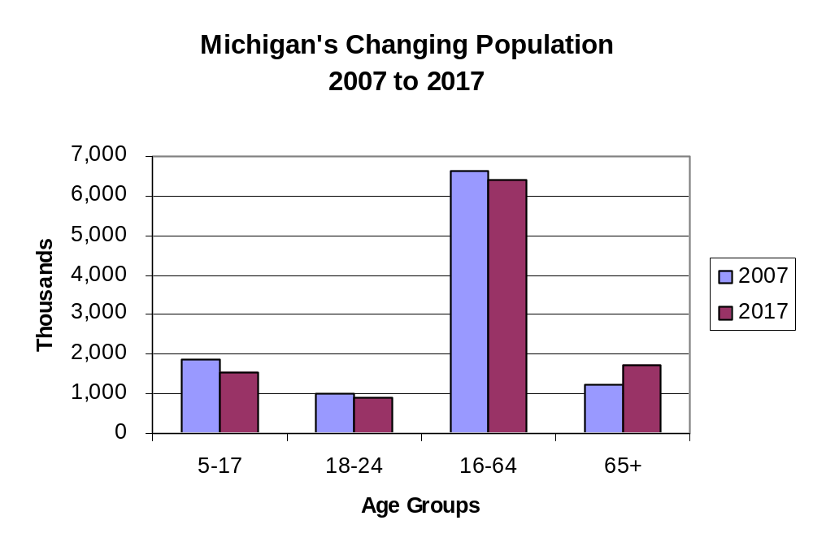
-3.9%
-14.3%
+31.5%
-8.5%
Notes:
Total -0.4%

Slide 28
Implications for State Government Finance
Revenues
Revenues from the current revenue system will grow slowly—even more slowly than the economy
Revenue (and taxes) declining as share of personal income
Official FY2009 forecasts used as the beginning point

Slide 29
Revenues
Analysis concentrates on General Fund and School Aid Fund revenues
Local government revenue sharing also included
Transportation revenues included
Each revenue source is projected separately based on the economic projections
Revenues are aggregated into total revenues available from current tax structure

Slide 30
Six Taxes
Account for 87% of General and School Aid Funds revenues
Aggregate growth rate about 2.4%
Higher growth rate will be needed to keep up with spending pressure increases
Remaining sources grow less than 2%

Slide 31
Growth Rates—General and School Aid Revenues
(FY2009-FY2017)
Income—3.25% (1.4% after tax changes)
Business—3.1%
Sales—3%
Use—3%
Tobacco—Minus 2.5%
State Education (Property)—4.25%
Other Sources—1.9%

Slide 32
Reasons for Sluggish Revenue Growth
Increasing senior citizen population—retirement income not taxed and spend less on goods
Consumption taxes goods oriented—economic growth is in service sector
Slow or no growth revenues drag down overall growth (e.g. tobacco, gambling, alcohol)
Flat rate income tax
Earned Income Tax Credit
Phase-out of Income Tax increase

Slide 33
Structural Deficit
Spending Pressures Outpace Revenue Growth
Over 85% of GF budget concentrated in four areas:
  Community Health ($3.1B)
  Corrections ($2 B)
  Higher Education ($2 B)
  Human Services ($1.3 B)
Most significant spending pressures:
  Health care
  Corrections
  Employee compensation – pay and fringes

Slide 34
Health Care Costs
Single largest component in state budget
  - Medicaid
  - Mental health services
  - Health insurance for school and state employees
  - Health insurance for school and state retirees
  - Health care provided to prisoners

Slide 35
Medicaid
Medical care for 1 in 7 Michigan citizens
Future spending growth pressures nearly 8% annually
Some state revenues dedicated to Medicaid do not grow—Tobacco Settlement revenues, Cigarette Tax
Others lag behind the overall growth in program
General Fund requirements grow nearly 11% annually
General Fund spending pressures outpace revenue five-fold
Notes:
Medicaid by itself will require annual increases in General Fund support larger than the growth in revenues
With spending increasing at 8% per year, in line with the projections at the national level and a lower rate than the last four years----the General Fund increases will need to be 12% annually to avoid cuts in services

Slide 36
Corrections
Largest state-operated program
30% of state employees
More than 50,000 prisoners and growth of 1,200 annually
58 prisons and camps
$30,000 per prisoner cost per year
Incarceration rate 44% higher than Great Lakes neighbors-the result: $500 million higher costs
Spending pressures will increase 7%, three times as fast as GF growth

Slide 37
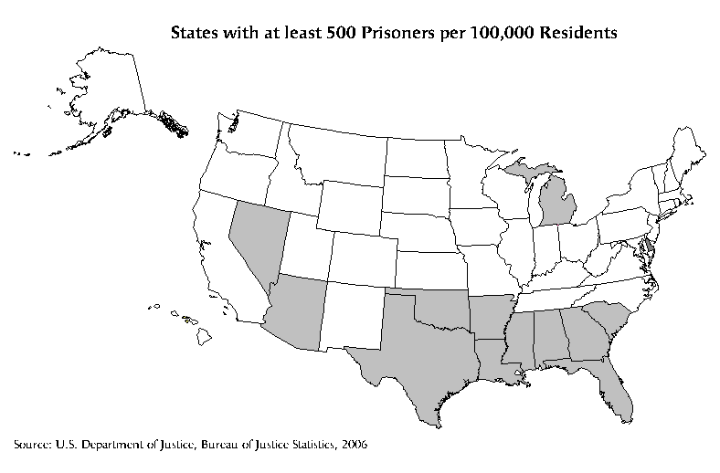
Notes:
Our incarceration rate is considerably higher than our neighboring states and more like the southern states than those in the mid-west, and the east and west coasts
If our incarceration rate was the same as the average of our closest neighbors---Ohio, Indiana, Wisconsin, and Illinois---The State could save as much as $400 million annually

Slide 38
Employee Compensation
Benefits significant portion of public budgets
  State: from 34% to 54% of base payroll between FY98 and FY07
Major driver is health care for current and retired employees
Failure to “pre-fund” retiree health = stresses budgets
  School retiree health more than double from FY07 to FY17, from 6.6% to 14% of payroll
Spending pressures grow 4.9% annually, twice as fast as GF revenues and nearly 50 percentage points faster than School Aid revenues

Slide 39
General Fund
Structural Deficit Remains
Spending pressures grow 6.7% per year
Baseline revenues grow 2.5% per year
Revenues grow unevenly due to EITC and Income Tax increase phase-out – adds to deficit in out years
  Average revenue growth reduced to 1.5% per year
Further revenue reductions occur in 2018 with elimination of the MBT surcharge

Slide 40
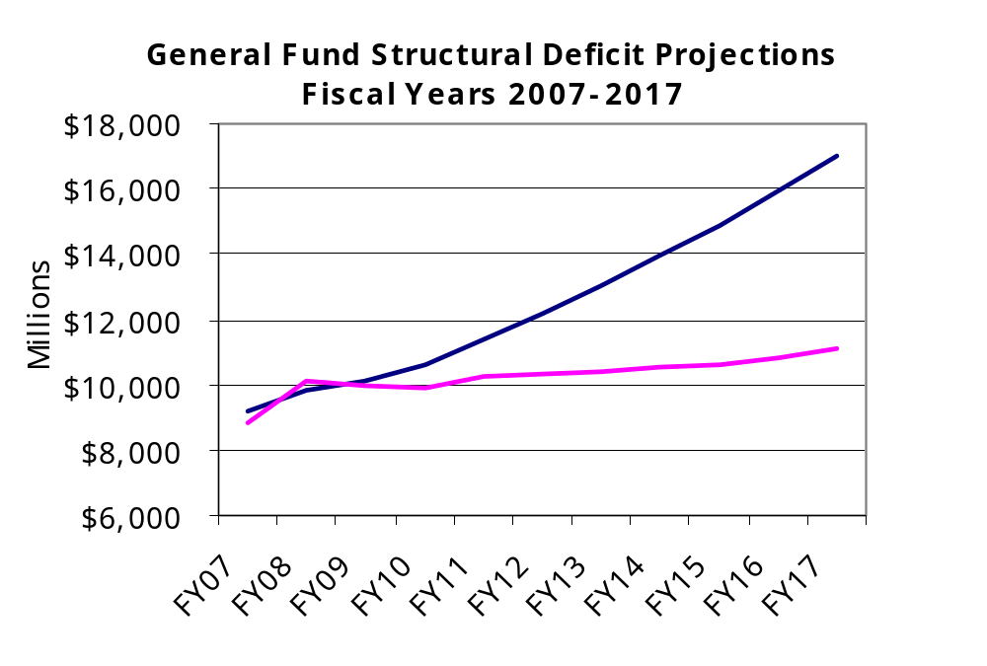

Slide 41
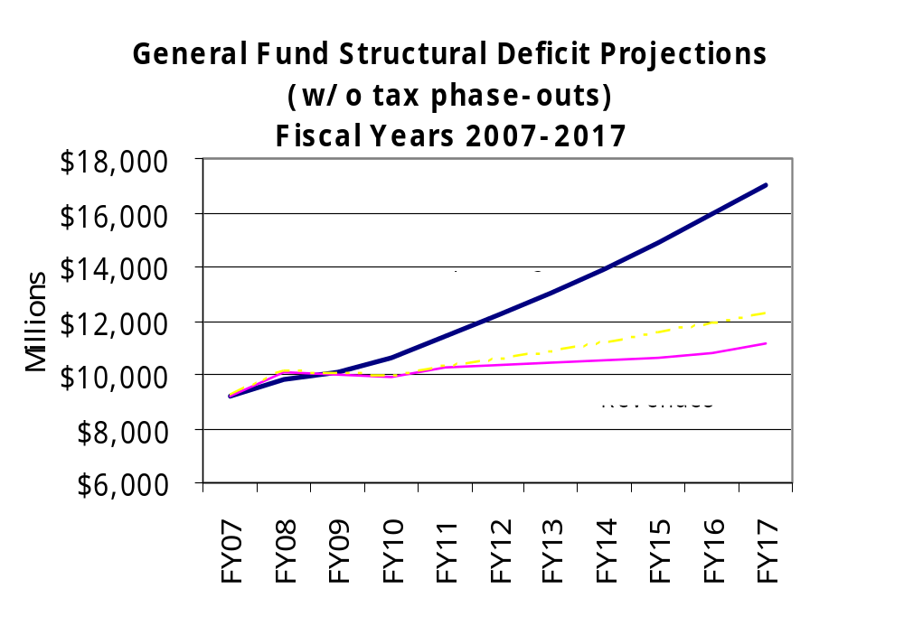
Revenue

Slide 42
School Aid Structural Deficit
Spending Pressures Outpace Revenue Growth
Retirement Contributions—rapid growth
Employee Health Insurance—rapid growth
General Pay Raises
Other—Fuel, Utilities, Supplies
Revenues Growing Slowly

Slide 43
School Aid Revenues & Spending Pressures
Spending pressures grow 4.6% per year
Revenues (state and local) grow 3.1% per year
Shortfall of 1.5% each and every year without spending and revenue policy changes

Slide 44
How does this translate at the classroom level?
Ave. per pupil revenue growth: $572
Spending pressures and “requirements”:
  Salaries - $375
  Retirement - $125
  Group insurances (health) - $275
  Other (fuel, utilities, etc.) - $100
Structural deficit of $300 per pupil (2.2%)

Slide 45
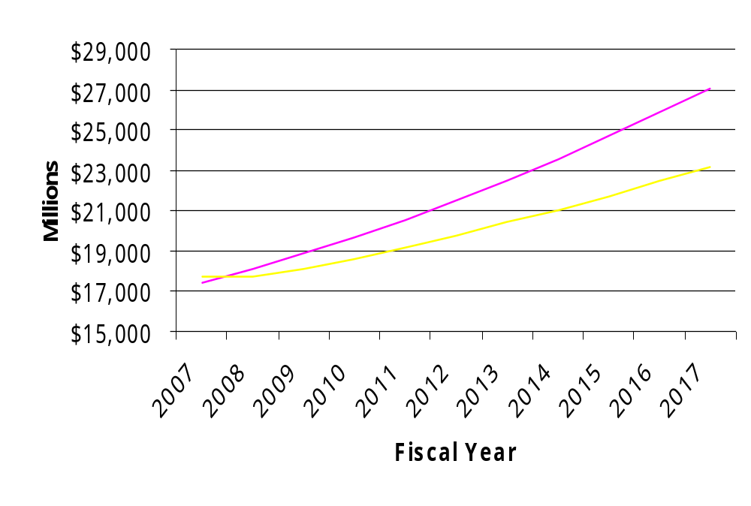
School Aid Structural Deficit Projections
FY2007 – FY2017

Slide 46
Policy Options
Achieving Long-Term Structural Balance
Increase revenue growth
Reduce rate of spending pressure growth
Bend the two curves so they meet

Slide 47
Revenues
Change system so revenues grow in line with economy and personal income
Consider taxing services broadly
Modify personal income tax by changing rate and exemptions—or—implement graduated income tax (Constitutional amendment required)
Consider taxing pensions and other retirement income (area of greatest income growth in future)
Reduce reliance on “sin” taxes

Slide 48
Tax Scenario Arithmetic
Expanding Sales and Use Taxes
  Exempt business-to-business
  Reducing rate to 3.6% (neutral)
  Adds about .8% to growth rate
Graduated Income Tax
  Revenue-neutral starting point
  Nearly doubles growth rate
Combined effects
  0.8% to School Aid Fund growth
  1.5% to General Fund growth
  Still work to do – spending solutions

Slide 49
Spending Scenario
Corrections
  Reducing prison incarceration rate to the average of our neighbors
  Ten-year phase-in
  Eliminates growth pressure in Corrections
  Reduces General Fund spending pressure growth by 1.1%
Health care
  Holding health care cost increases to 5% per year
  Reduces General Fund annual spending pressure growth by 1.6%
  Reduces School Aid annual spending pressure growth by 1.1%

Slide 50
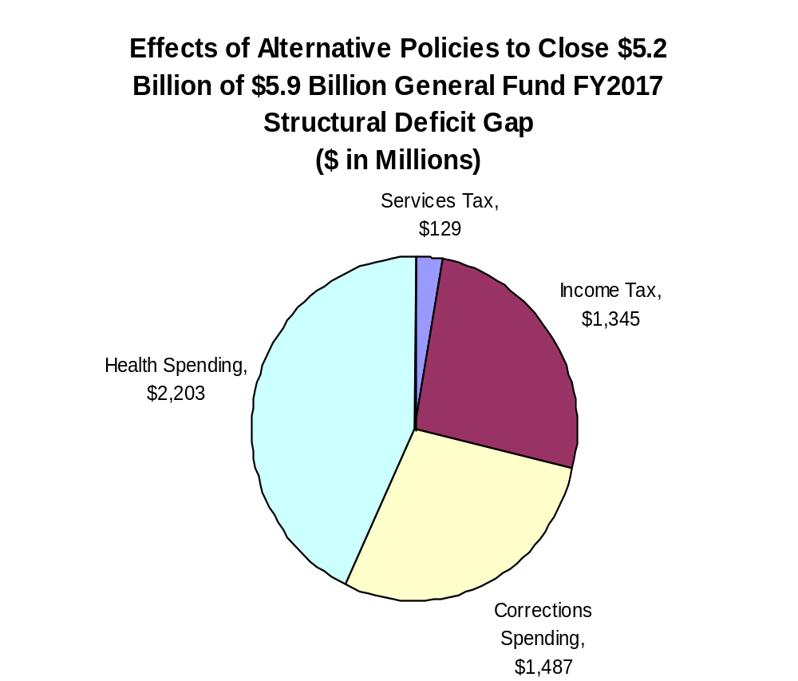

Slide 51
Citizens Research Council of Michigan
CRC Publications available at
www.crcmich.org
Providing Independent, Nonpartisan Public Policy Research Since 1916

